Slide 1
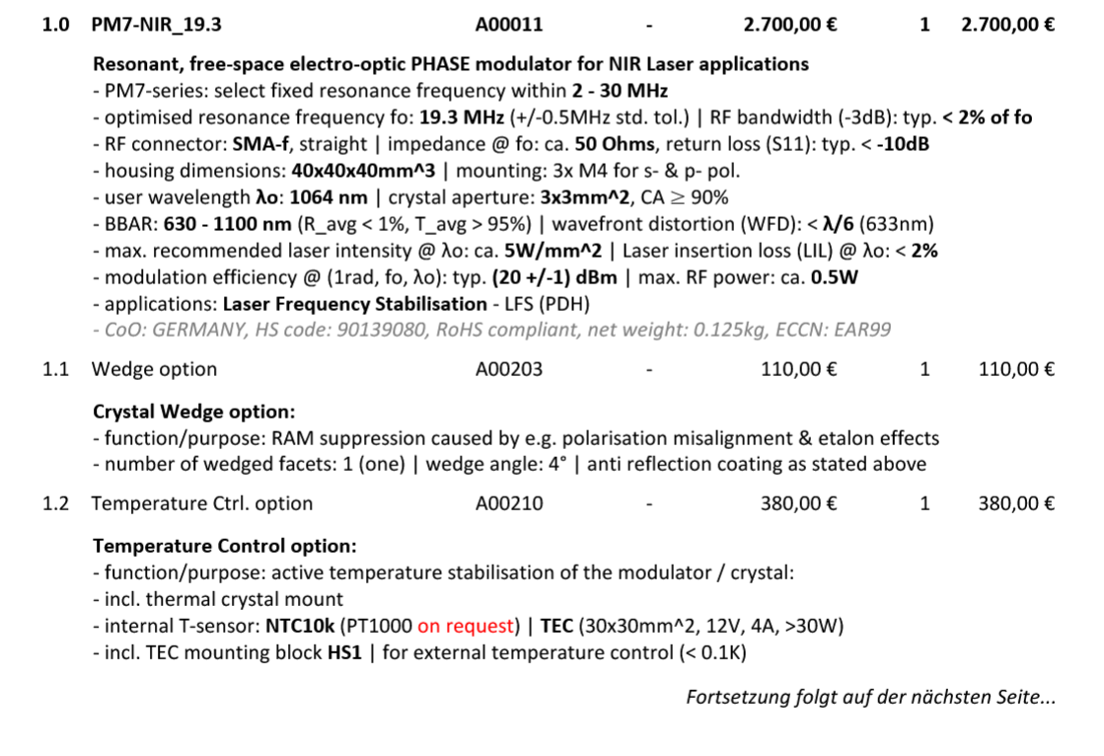

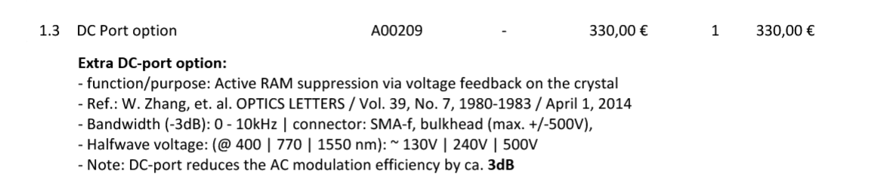

Free-space Resonant EOMs for PDH
From Qubig
?
They can provide a temp. controller

